Slide 1
Question 1: Systematic AI Fund
Liam Andrew Beattie - 22562435

Slide 2
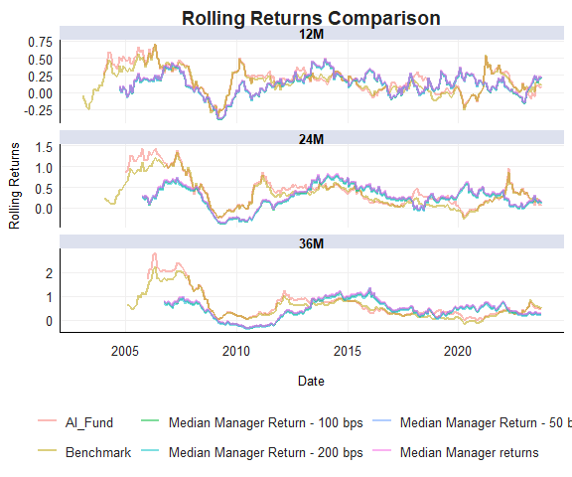

Slide 3
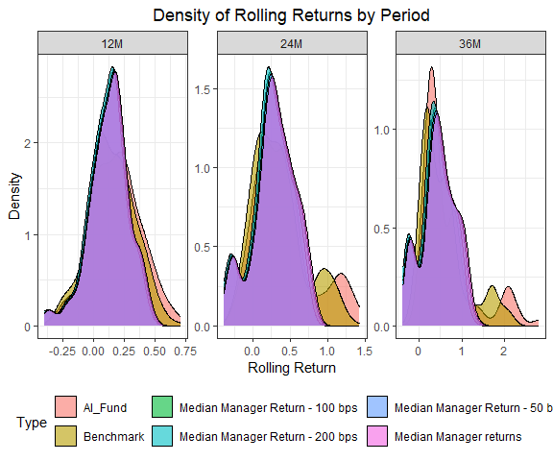

Slide 4
